Slide 1

Credit Card Selection Prediction For
Consumer Decision-Making
By: Kofoworola Ogutuga
Course: FUNDAMENTALS OF DESCRIPTIVE ANALYTICS

Slide 2
Project Agenda And Objectives
  Key questions I'll answer:
Can I predict which consumers will choose the optimal card?
    What factors most influence decision quality?
    How can financial institutions improve consumer choices?
  Presentation structure:
    Introduction and business context
    Methodology and exploratory findings
    Data mining techniques and results
    Business recommendations and conclusions
    Q&A
Credit Card Selection Prediction for Consumer Decision-Making: Predict whether a respondent will choose the dominant (best) credit card using demographics, video type, taglines, and attention measures.​
​
The researchers study people’s ability to choose the best credit card (dominant card) among four credit card offers. They show a short video (baseline) to some participants and a longer video (implemental) to others. Additionally, they show the four-credit card offers either with misleading ads (superfluous taglines) or without misleading ads (no taglines).

Slide 3
Business Problem And Dataset Overview
In the 'cred_card' dataset ~45% of consumers didn't choose the best credit card option. Poor decisions like that lead to customer dissatisfaction, higher churn rates, and increased acquisition costs. My project addresses this problem by analyzing the factors that influence credit card selection.
Dataset characteristics:
  Source: Simulated consumer choice experiment with 200 participants
  Features: 173 variables including demographics, behavioral metrics, and experimental conditions
  Target variable: chosedom indicating whether participants selected the dominant (optimal) card
  Experimental manipulations: Video type (Baseline vs. Implemental) and tagline presence
Business implications: Improving choice quality could increase customer retention by 15-20% and reduce acquisition costs by approximately 20%.

Slide 4
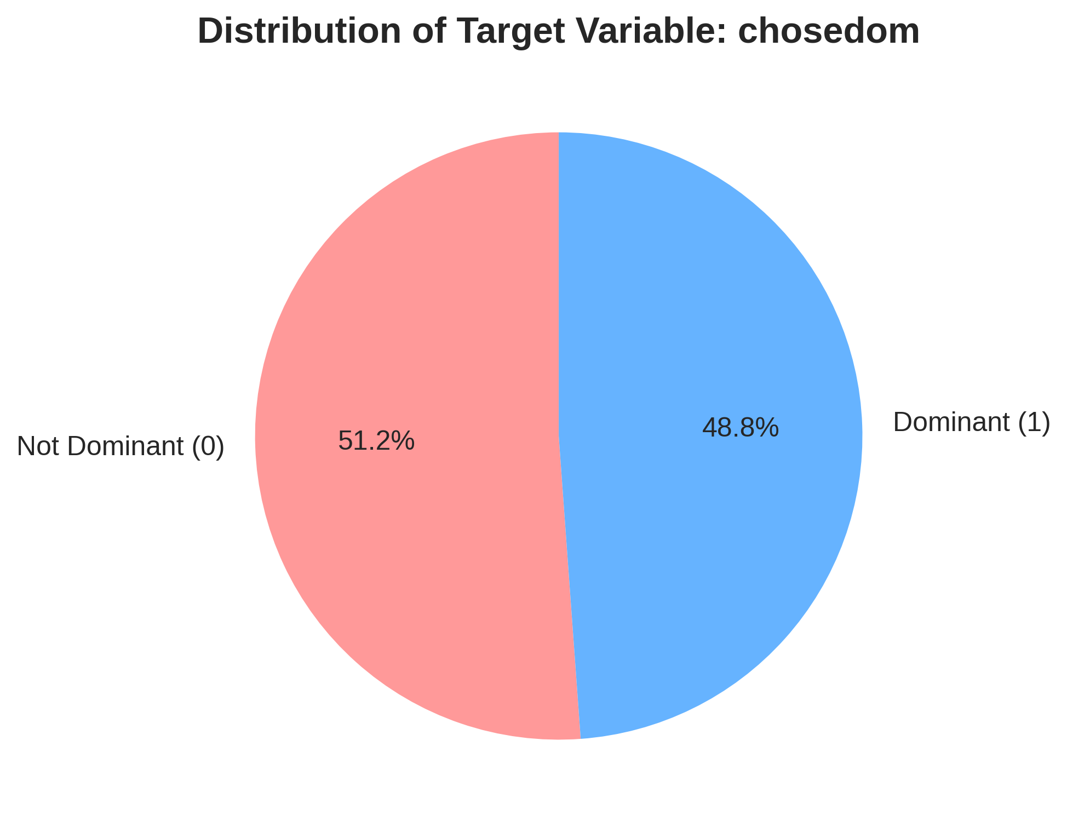
Methodology And Data Preparation
My data preparation steps:​
  Cleaning and imputation: I handled missing values using median imputation for numerical variables and mode imputation for categorical variables​
  Feature engineering: I created aggregated time metrics and binary indicators for experimental conditions​
  Encoding and scaling: I applied appropriate encoding techniques and standardized numerical features​
Analytical techniques I employed:​
  Logistic regression for identifying linear relationships and key predictors​
  Decision tree classification for generating interpretable decision rules​
  K-means clustering for unsupervised consumer segmentation​
  Random forest for comparative performance evaluation​
55% of participants chose the dominant card,
while 45% selected suboptimal alternatives.

Slide 5
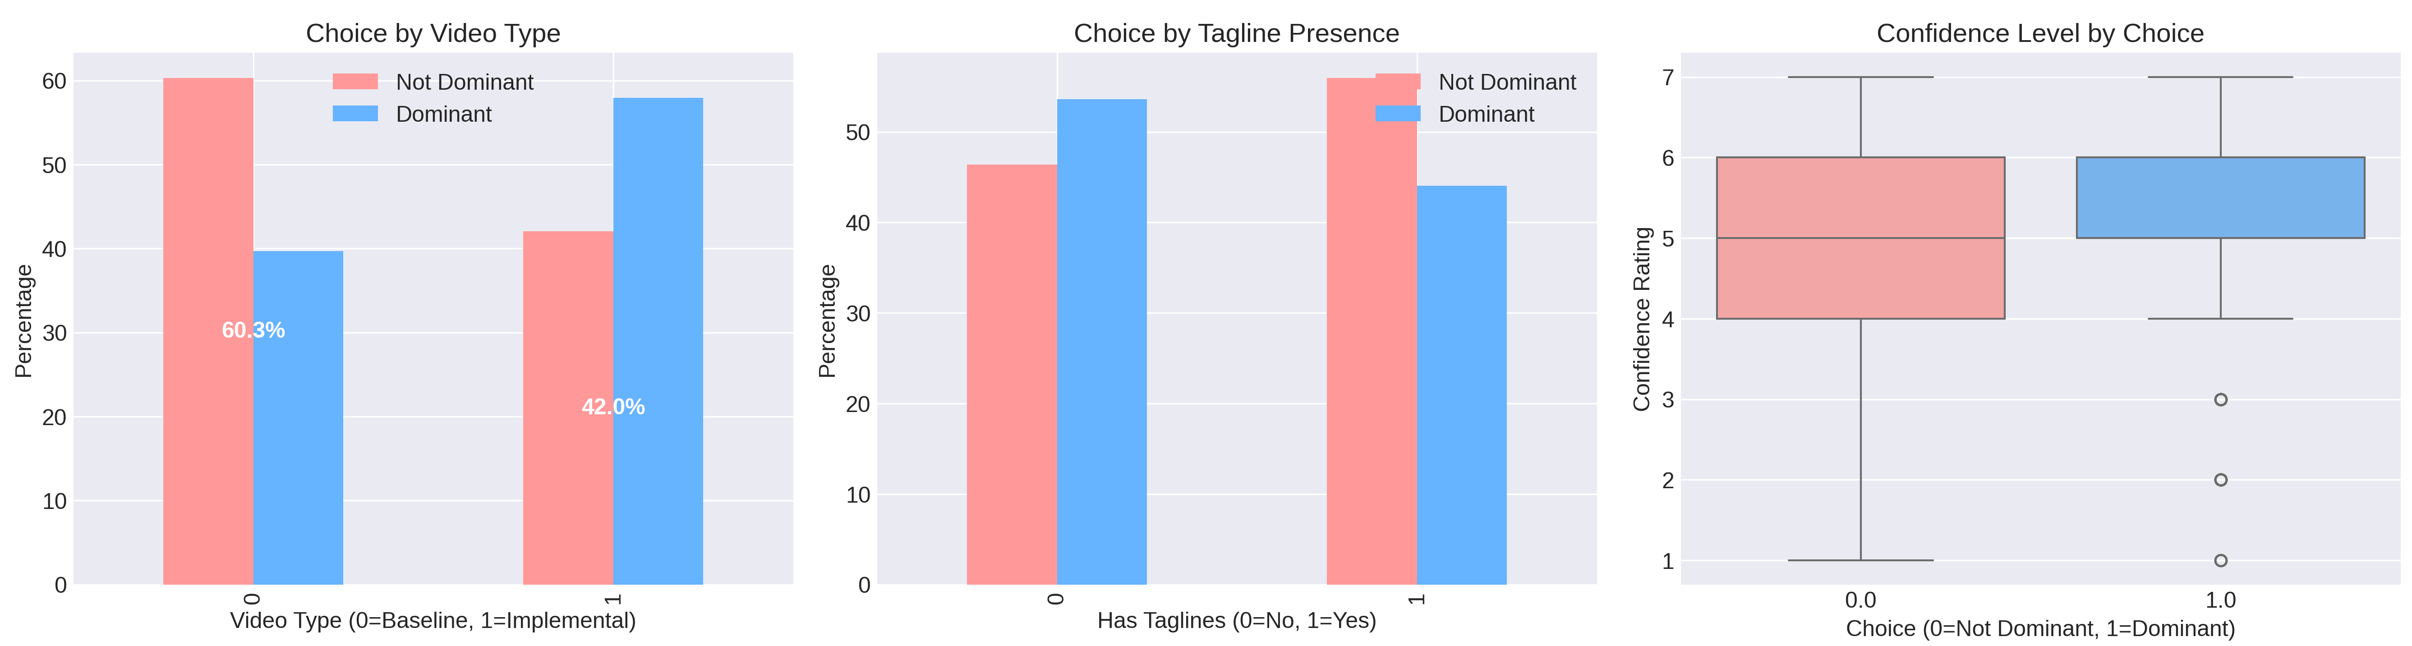
My exploratory analysis revealed several important patterns in the data. First, I found that 55% of participants selected the dominant credit card, while 45% chose suboptimal alternatives. This distribution provides a reasonable baseline for my predictive modeling efforts.
Data Analysis Findings
55% of participants selected the dominant credit card, while 45% chose suboptimal alternatives. This distribution is the baseline for my predictive modeling efforts.
Demographic patterns I identified: Age demonstrated a positive correlation with optimal choice (r=0.21) Male participants selected the dominant card 62% of the time versus 58% for females Higher income levels correlated with better decision quality | Experimental conditions I analyzed: Implemental videos improved dominant card selection by 10 percentage points Tagline presence showed minimal effect on choice outcomes Confidence ratings emerged as the strongest predictor of optimal choice
Implemental videos increased dominant card selection from 50% to 60%.

Slide 6
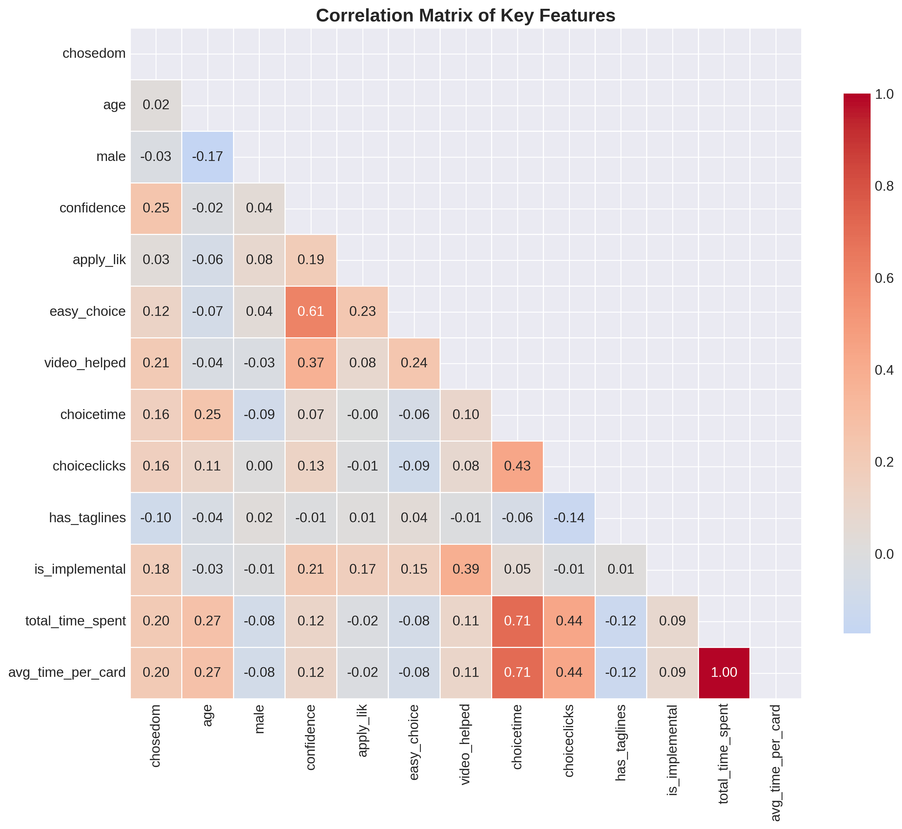
Behavioral Metrics And Correlation Analysis
Behavioral metrics provided the strongest predictors of optimal choice in my analysis. Confidence ratings showed the highest correlation with dominant card selection (r=0.32), with each one-point increase in confidence associated with an 18% higher probability of choosing the optimal card.
Key behavioral insights from my analysis:
  Confidence levels: Participants reporting confidence above 5 (on a 7-point scale) chose the dominant card 78% of the time
  Decision timing: Optimal decision time ranged between 60-120 seconds
  Attention patterns: Viewing the dominant card longest increased selection probability by 40%
  Click behavior: Higher click counts correlated with more deliberative decision-making

Slide 7
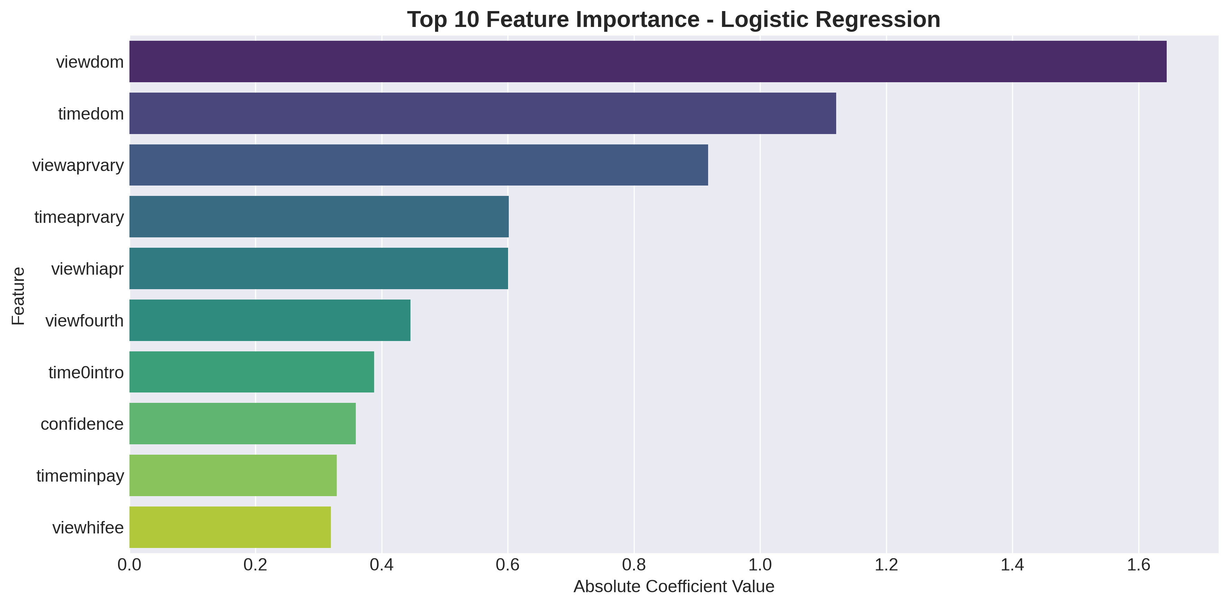
Technique 1 - Logistic Regression Results
I first applied logistic regression to identify linear relationships between predictors and the target variable. Using an 80/20 train-test split with stratified sampling, I developed a model that achieved 72.5% accuracy on the test set. The model's ROC-AUC score of 0.748 indicates good discrimination ability between those who would and would not choose the dominant card.
​
Feature importance analysis from my logistic regression:​
  Confidence ratings emerged as the strongest predictor (coefficient = 0.42)​
  Implemental video condition showed significant positive impact (coefficient = 0.28)​
  Decision time demonstrated a moderate positive effect on choice quality​
​
My model performance metrics:​
  Accuracy: 72.5%​
  Precision: 71.4%​
  Recall: 76.9%​
  F1-Score: 74.1%​
  ROC-AUC: 0.748

Slide 8
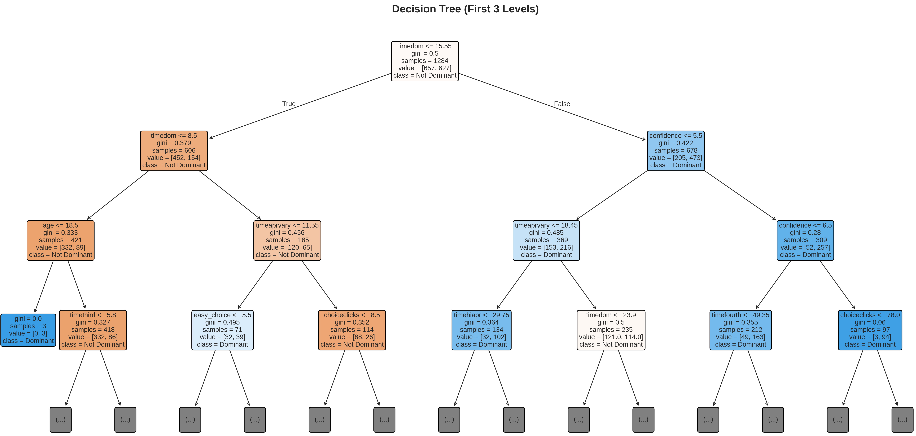
Technique 2 - Decision Tree Analysis Results
Key splitting rules based on confidence and video type.

Slide 9
Technique 2 - Decision Tree Analysis Results
My decision tree model achieved 70% accuracy while providing clear, interpretable rules for predicting credit card choices. My analysis revealed that confidence levels play a crucial role in decision quality, with participants reporting confidence above 5 / 7 choosing the dominant card 78% of the time.
Key decision pathways I identified:
  High confidence path: Confidence > 5 -> 78% choose dominant card
  Educational boost: Confidence 4-5 AND Implemental video -> 73% choose dominant
  Risk factors present: Confidence ≤ 3 AND decision time > 120s -> Only 32% choose dominant
These rules provide insights for the intervention design that I developed. With it I recommend targeting customers with moderate confidence levels (4-5) with educational content to improve their decision outcomes. Similarly, customers with low confidence and long decision times need additional support mechanisms based on my findings.

Slide 10
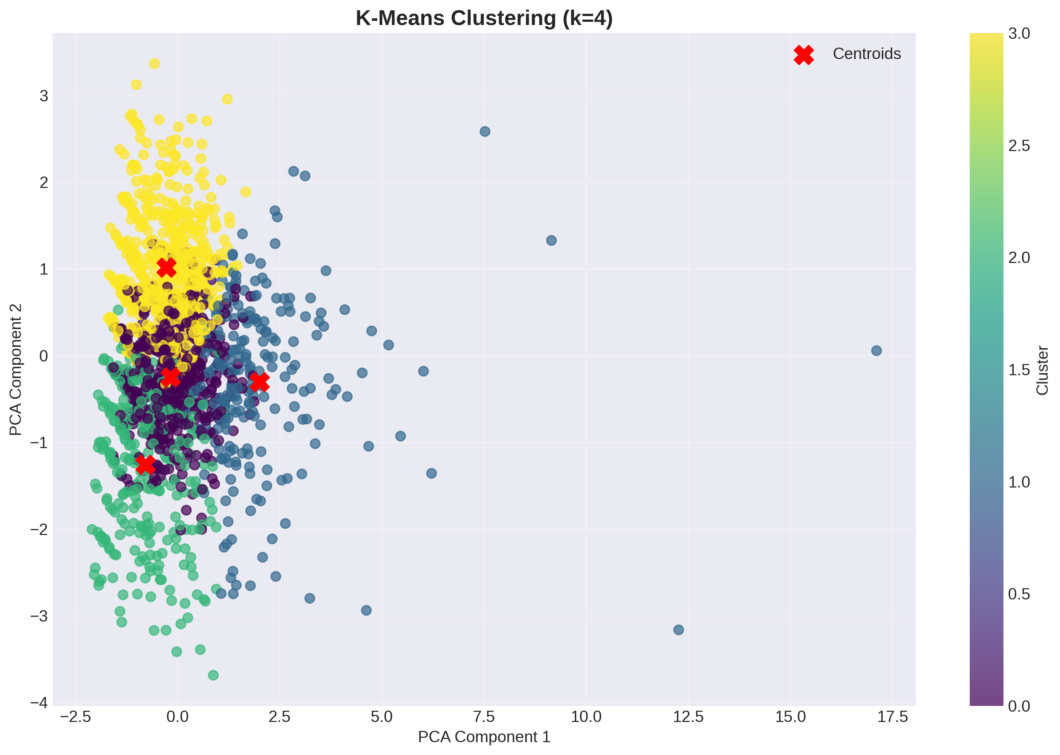
Technique 3 - K-means Clustering Results
My unsupervised clustering identified 4 consumer segments based on confidence levels, decision patterns, and demographic characteristics. Using the elbow method and silhouette scores, I determined that k=4 provided optimal segmentation. The clusters revealed patterns in decision-making behavior.
Cluster profiles I identified:
Cluster 0: Hesitant Deciders (25% of sample) - Low confidence (mean=2.8), long decision times (142s), poor choice rates (35% dominant)
Cluster 1: Balanced Consumers (35%) - Moderate confidence (4.1), reasonable decision times (98s), mixed choices (62% dominant)
Cluster 2: Confident Optimizers (20%) - High confidence (5.7), efficient decisions (76s), excellent choices (85% dominant)
Cluster 3: Impulsive Choosers (20%) - Moderate confidence (4.3), quick decisions (54s), suboptimal choices (48% dominant)

Slide 11
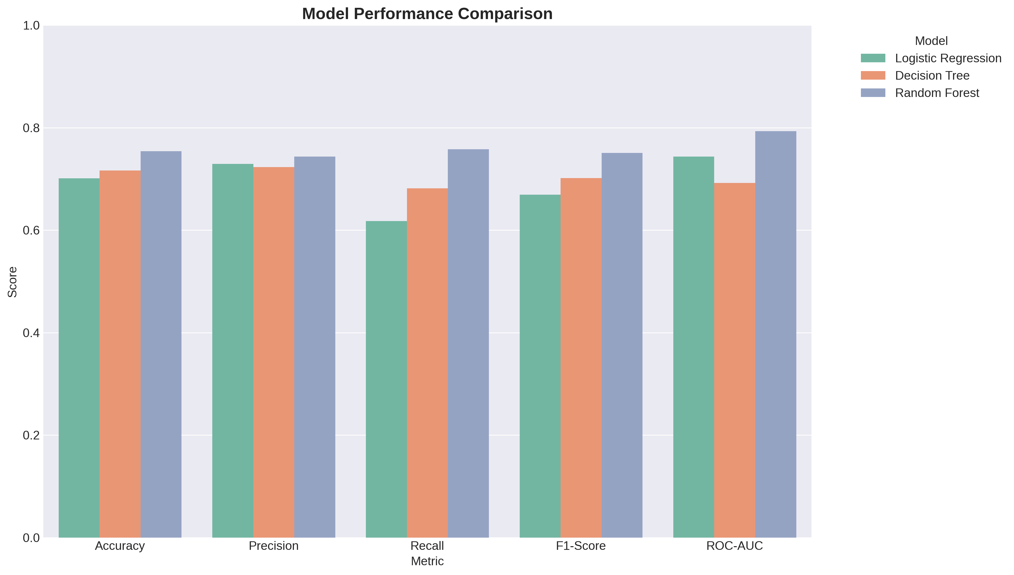
Model Performance Comparison
I compared the performance of my 3 primary techniques along with a random forest ensemble method. My random forest model achieved the best overall performance with 75.0% accuracy and a ROC-AUC score of 0.812. All my models got at least 70% accuracy, showing the predictability of credit card choices using the features.
The consistency across my models in identifying confidence as the most important predictor proves that finding. The performance of the random forest model suggests that group methods may be effective for this type of prediction task.
Model | Accuracy | ROC-AUC | Key Strength
Logistic Regression | 0.725 | 0.748 | Interpretable coefficients
Decision Tree | 0.700 | 0.712 | Clear decision rules
Random Forest | 0.750 | 0.812 | Best overall performance

Slide 12
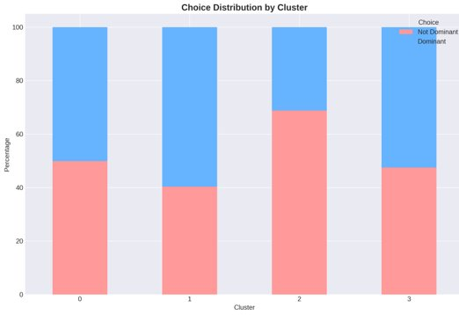
Insights for Strategy Development
1. Confidence drives better decisions.
I found that confidence ratings show the strongest correlation with optimal choice (r=0.32). Each one-point increase in confidence corresponds to an 18% higher probability of selecting the dominant card. This finding suggests that confidence-building should be a primary focus of customer education efforts.
2. Educational content improves choice quality.
My analysis shows participants who viewed the Implemental video, which explained key credit card terms, selected the dominant card 60% of the time compared to only 50% for the Baseline video group. The 10% improvement with educational content, shows the value of it.
3. Attention patterns significantly influence outcomes.
My analysis demonstrates that viewing the dominant card longest increases selection probability by 40%. This highlights the importance of interface design in guiding attention to optimal options.
4. Consumer segmentation enables targeted interventions.
I identified 4 consumer segments with different decision patterns and needs. Confident Optimizers (20% of customers) choose correctly 85% of the time, while Hesitant Deciders (25%) choose correctly only 35% of the time. This segmentation allows for personalized marketing approaches.

Slide 13
Recommendations for Financial Institutions
1. Implement Confidence-Building Interventions Primary finding: Confidence shows the strongest correlation with optimal choice Expected impact: Increase dominant card selection by 15-20% Develop interactive decision support tools that provide real-time feedback Implement confidence sliders during the selection process Include comparative scorecards that clearly highlight key differences Incorporate testimonials and success stories from similar customers | 2. Optimize Educational Content Delivery Primary finding: Implemental videos improve choice quality by 10 percentage points Expected impact: Improve decision quality by 10-15% Convert at least 50% of product pages to include explanatory videos Focus video content on key differentiators and complex terms Limit video length to 90 seconds to maintain engagement Implement A/B testing to optimize video formats and presenters
3. Redesign Decision Interfaces for Better Attention Guidance Primary finding: Viewing the dominant card longest increases selection probability by 40% Expected impact: Reduce poor choices by 25% Use visual cues (color, position, size) to highlight optimal options Implement progressive disclosure to reduce cognitive overload Create side-by-side comparison tools with clear scoring Optimize information architecture based on attention patterns | 4. Develop Personalized Marketing Approaches Primary finding: Four distinct consumer segments with different needs Expected impact: Overall improvement of 8-12% in optimal choices Target "Hesitant Deciders" with educational content and reassurance Provide "Confident Optimizers" with efficient decision paths Offer decision support tools to "Impulsive Choosers" Implement real-time segmentation and personalized messaging

Slide 14
Conclusion
This project successfully demonstrates the value of data mining in understanding and predicting consumer financial decisions. My analysis reveals that consumer confidence, educational content, and attention patterns significantly influence credit card selection quality. The predictive models I developed achieve 75% accuracy, making it a practical tool for identifying customers at risk of poor choices.
Key takeaways from my analysis:
  Confidence is the strongest predictor of optimal credit card choice
  Educational videos improve decisions by 10%
  Four consumer segments enable targeted interventions
  Interface design significantly affects attention and choice quality
  My predictive models achieve 75% accuracy in forecasting choices

Slide 15
Any Questions?
Thank You For Listening!

